Slide 1

Relational Database Project Using SQL for Amazon Orders
Project by Bhavna Bhalani
https://github.com/BhavikaBhalani/Project-of-Relational-database-on-Amozone-order-using-SQL

Slide 2
Introduction
This project analyzes an Amazon e-commerce dataset, which includes comprehensive information about products, categories, customers, orders, and more. The dataset's eight tables—categories, customers, employees, orders, orderdetails, products, shippers, and suppliers—provide detailed insights into Amazon's business operations. By examining this data, we aim to uncover patterns and trends that can enhance understanding of Amazon's order processes, customer behavior, and supply chain dynamics.

Slide 3
Schema Design and Alignment
Categories: Holds information about product categories.
Customers: Contains customer information.
Employees: Stores employee data.
Orders: Tracks orders placed by customers, linked to Customers, Employees, and Shippers.
Order Details: Contains detailed information about each order, linked to Orders and Products.
Products: Holds product information, linked to Suppliers and Categories.
Shippers: Stores shipping company details.
Suppliers: Contains supplier information.

Slide 4
Foreign Key Relationships
Orders.CustomerID references Customers.CustomerID.
Orders.EmployeeID references Employees.EmployeeID.
Orders.ShipperID references Shippers.ShipperID.
OrderDetails.OrderID references Orders.OrderID.
OrderDetails.ProductID references Products.ProductID.
Products.SupplierID references Suppliers.SupplierID.
Products.CategoryID references Categories.CategoryID.

Slide 5
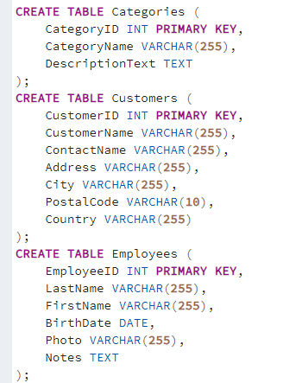
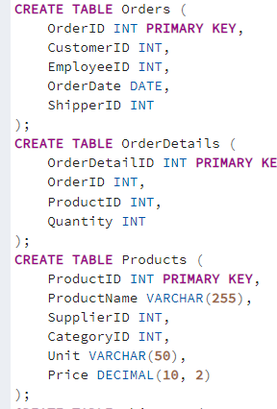
TABLES

Slide 6
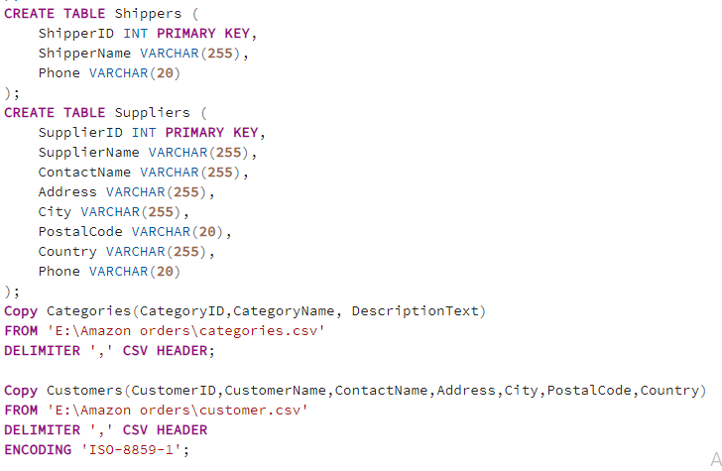

Slide 7
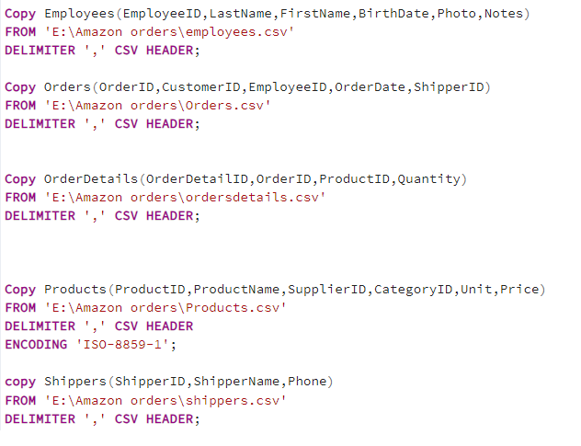


Slide 8
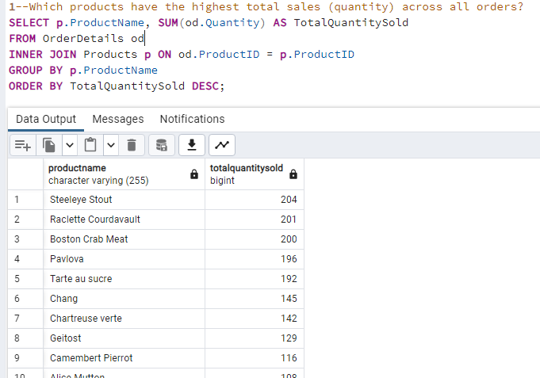

Slide 9
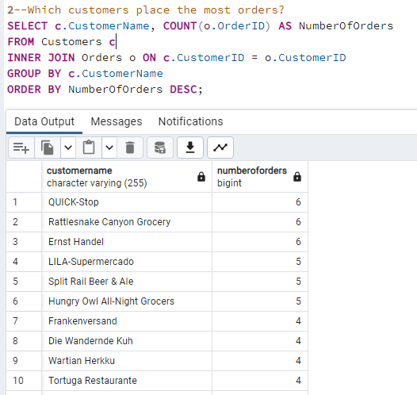

Slide 10
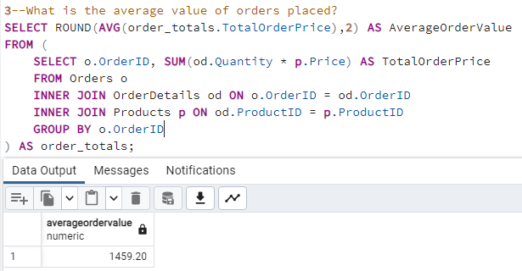

Slide 11
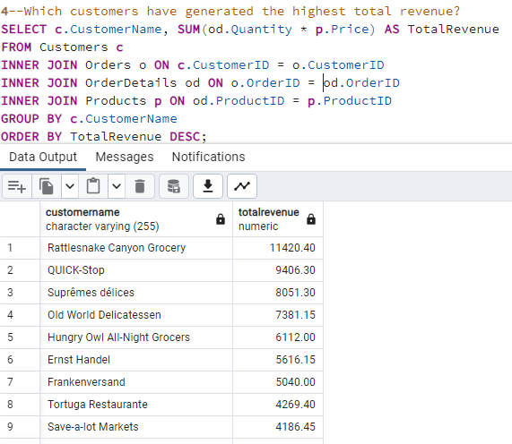

Slide 12
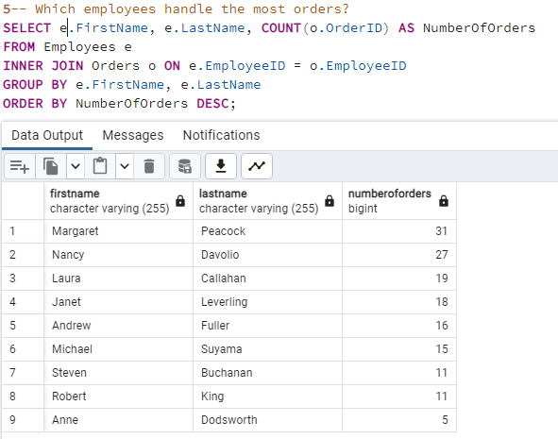

Slide 13
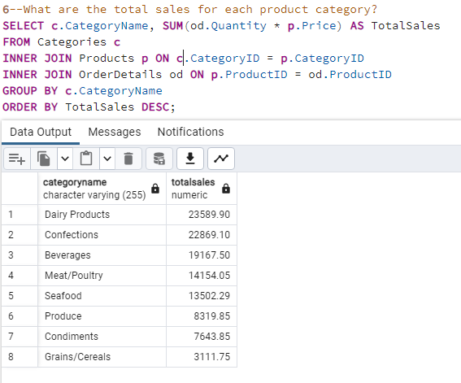

Slide 14
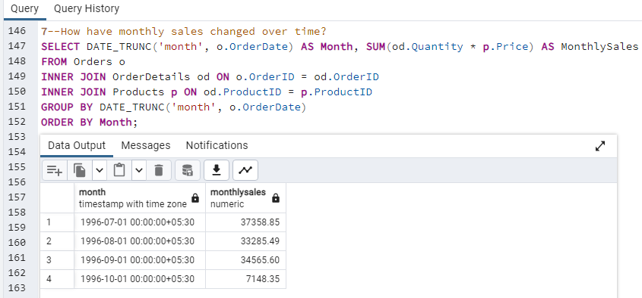

Slide 15
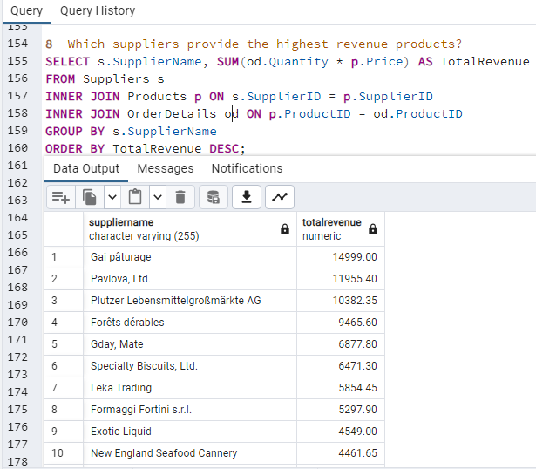

Slide 16
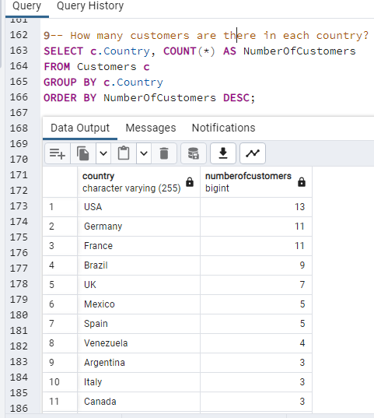

Slide 17
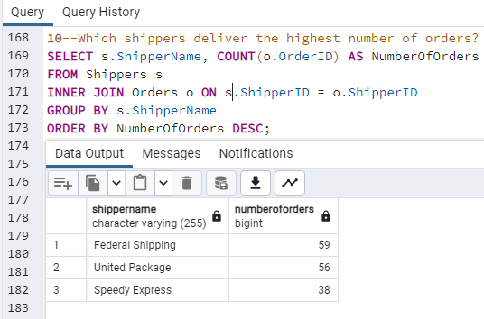

Slide 18
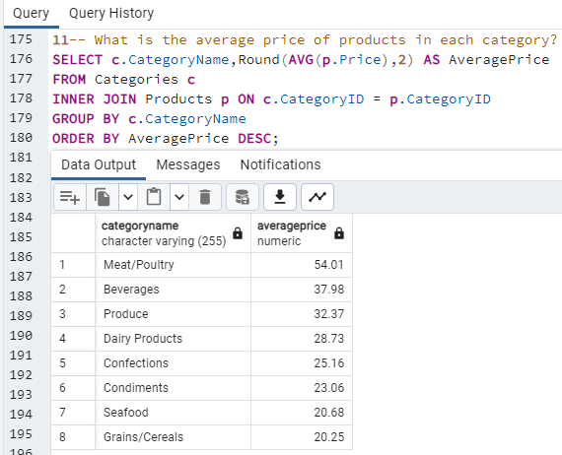

Slide 19
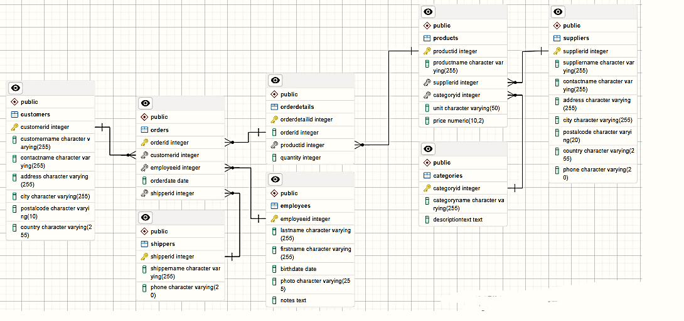
ER Diagram

Slide 20
CONCLUSION
This project offers a comprehensive schema design for an Amazon e-commerce database, structured to manage detailed information across various business entities. By integrating eight interconnected tables—Categories, Customers, Employees, Orders, OrderDetails, Products, Shippers, and Suppliers—the database effectively supports Amazon's complex operations.
The well-defined relationships between entities ensure data integrity and enable insightful analysis. Linking orders with customers, employees, and shippers provides a complete view of the order fulfillment process. Similarly, connecting products with suppliers and categories enhances inventory management and product organization.
This robust schema design ensures efficient data management, supports diverse analytical queries, and provides a solid foundation for strategic decision-making. It reflects the complexity of Amazon's e-commerce ecosystem, promoting operational efficiency and improved customer satisfaction.

